Slide 1
Technology Considerations
Consider the expressions for the first eight carries in CLA (carry lookahead adder):
c1 = g0 + p0c0
c2 = g1 + p1g0 + p1p0c0
...
c8 = g7 + p7g6 + p7p6g5 + p7p6p5g4 + p7p6p5p4g3 + p7p6p5p4p3g2 + p7p6p5p4p3p2g1 + p7p6p5p4p3p2p1g0 + p7p6p5p4p3p2p1p0c0

Slide 2
Suppose that the maximum fan-in of the gates is four inputs. Then it is impossible to implement all of these expressions with a two-level AND-OR circuit. The biggest problem is c8, where one of the AND gates requires nine inputs; moreover, the OR gate also requires nine inputs. To meet the fan-in constraint, we can rewrite the expression for c8 as
c8 = (g7 + p7g6 + p7p6g5 + p7p6p5g4)
+ [( p7p6p5p4)(g3 + p3g2 + p3p2g1 + p3p2p1g0)]
+ ( p7p6p5p4)( p3p2p1p0)c0

Slide 3
To implement this expression we need ten AND gates and three OR gates. The propagation delay in generating c8 consists of one gate delay to develop all gi and pi , two gate delays to produce the sum-of-products terms in parentheses, one gate delay to form the product term in square brackets, and one delay for the final ORing of terms. Hence c8 is valid after five gate delays, rather than the three gate delays (1 to generate Gi and Pi, 1 by all AND gates and 1 by all OR gates) that would be needed without the fan-in constraint.

Slide 4
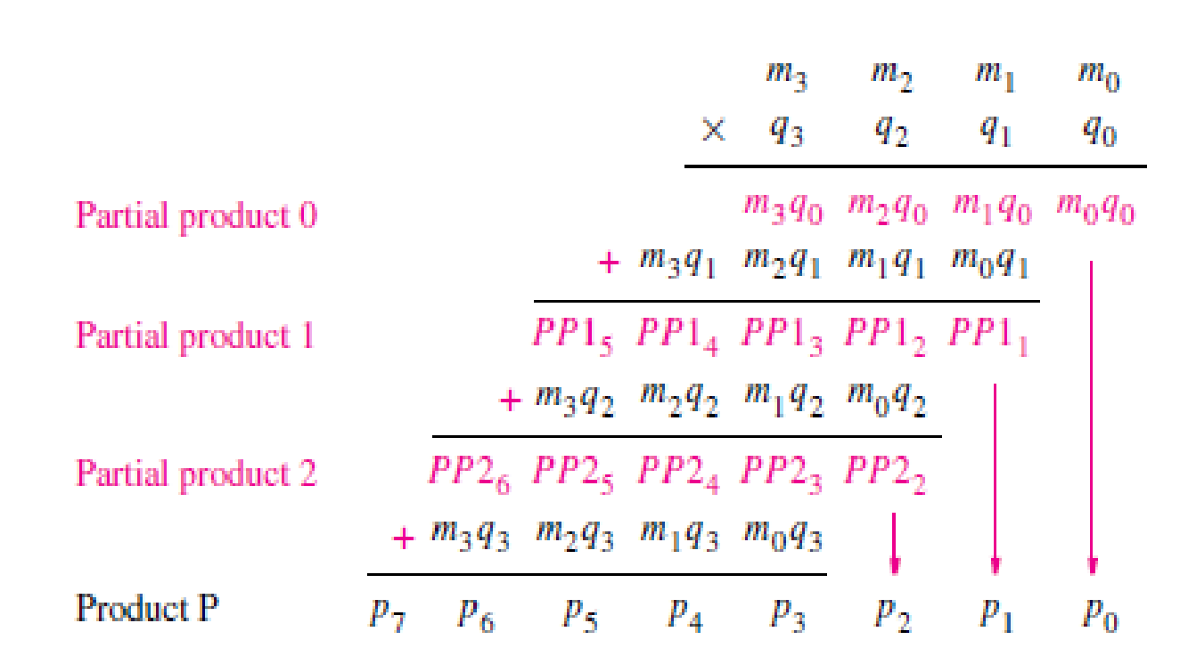
Multiplication
Two binary numbers can be multiplied using the same method as we use for decimal numbers.

Slide 5
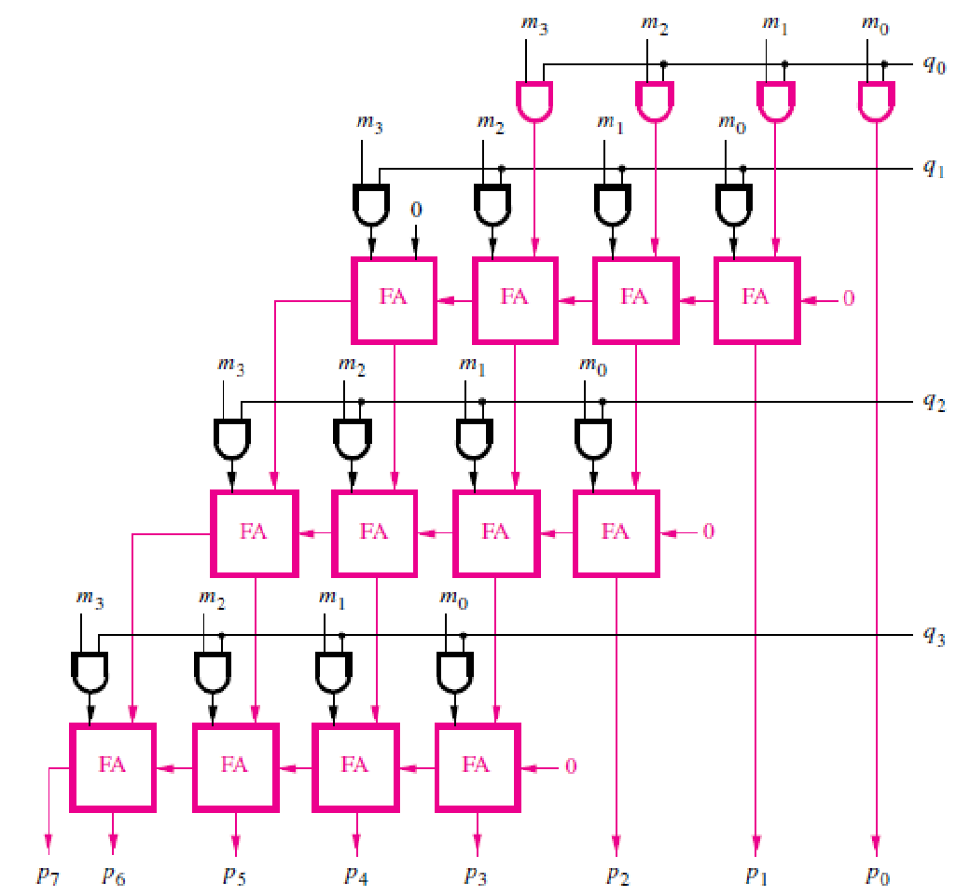

Slide 6
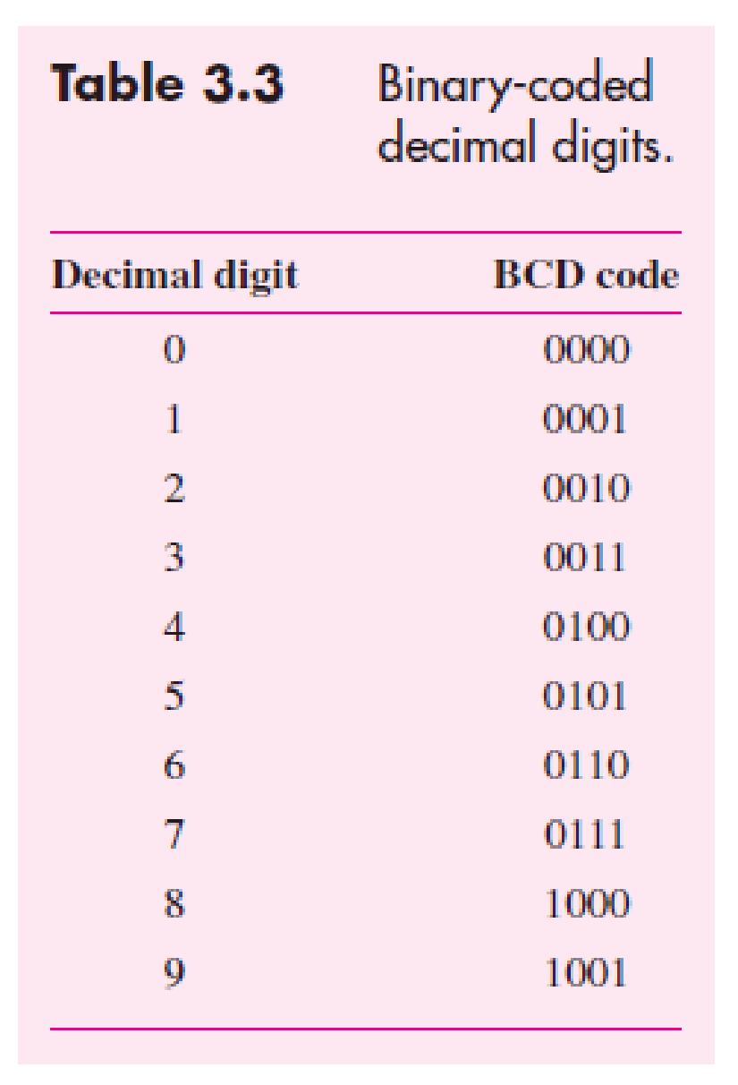
Binary-Coded-Decimal Representation

Slide 7
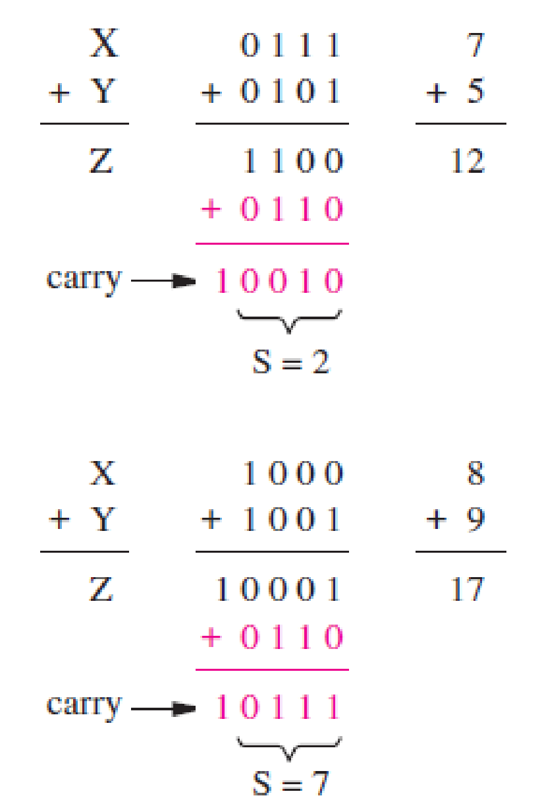
BCD Addition

Slide 8
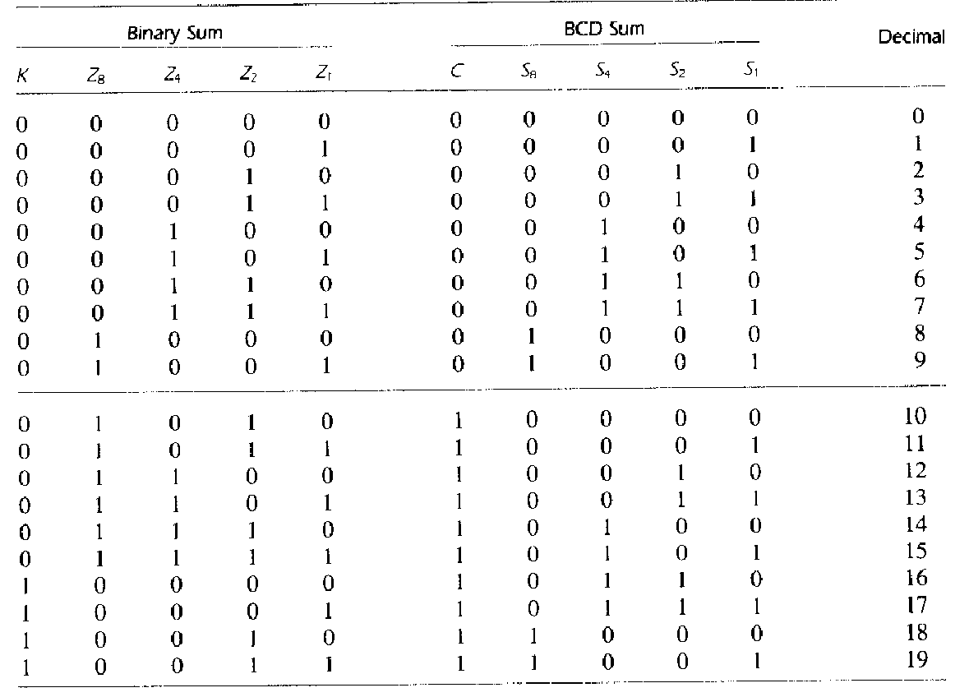

Slide 9
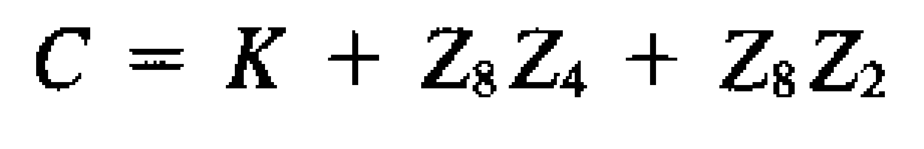
z2, z1
z8, z4
 | 00 | 01 | 11 | 10
00 | 0 | 0 | 0 | 0
01 | 0 | 0 | 0 | 0
11 | 1 | 1 | 1 | 1
10 | 0 | 0 | 1 | 1
Correction should be done when the carry k = 1 or when the expression z8z4 + z8z2 evaluates to 1. Therefore the expression for the correction circuit is

Slide 10
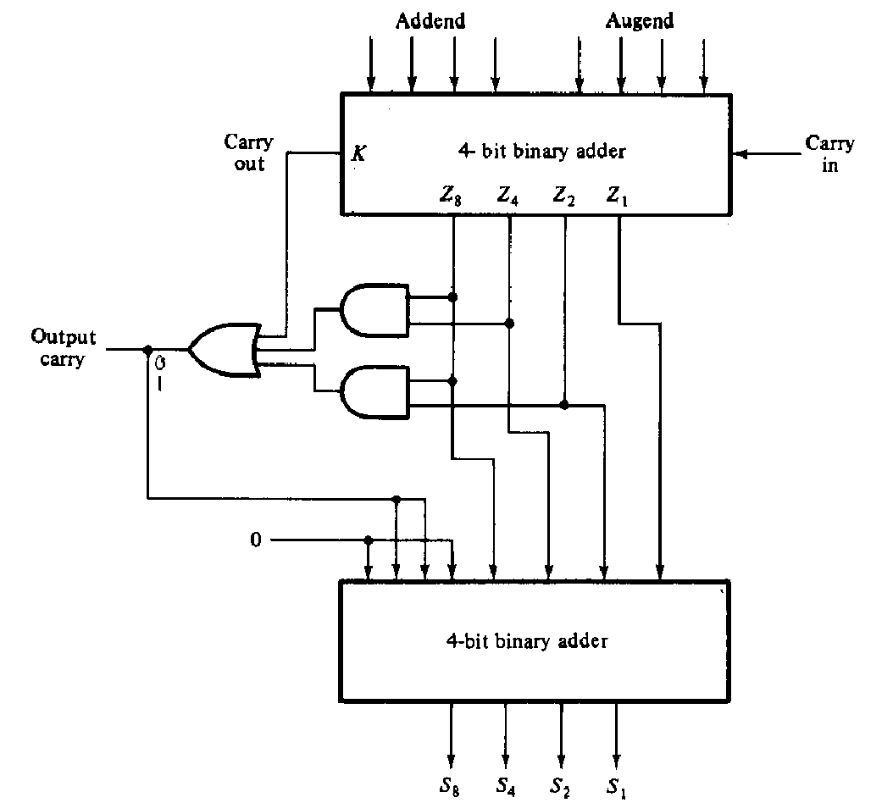

Slide 11
Y1
X1
Y0
X0
4
4
Single digit bcd adder1
Single digit bcd adder0
Cout1
Cin
Cout0
4
4
S1
S0

Slide 12
Exercise 1
Design a circuit using full adders to generate 2’s complement of a 4 bit number X
x3
x2
x1
x0
0
0
0
0
1
y3
y2
y1
y0
y3y2y1y0 is the 2’s complement of X

Slide 13
Exercise 2
Design a circuit using full adders to find the no. of 1’s in a three bit unsigned number
x2
x1
FA
x0
c
s
CS is the result in binary.

Slide 14
Example
Problem: In computer computations it is often necessary to compare numbers. Two four-bit signed numbers, X = x3x2x1x0 and Y = y3y2y1y0, can be compared by using the subtractor circuit. The three outputs denote the
following:
• Z = 1 if the result is 0; otherwise Z = 0
• N = 1 if the result is negative; otherwise N = 0
• V = 1 if arithmetic overflow occurs; otherwise V = 0
Show how Z, N, and V can be used to determine the cases X = Y , X < Y , X ≤ Y , X > Y , and X ≥ Y.

Slide 15
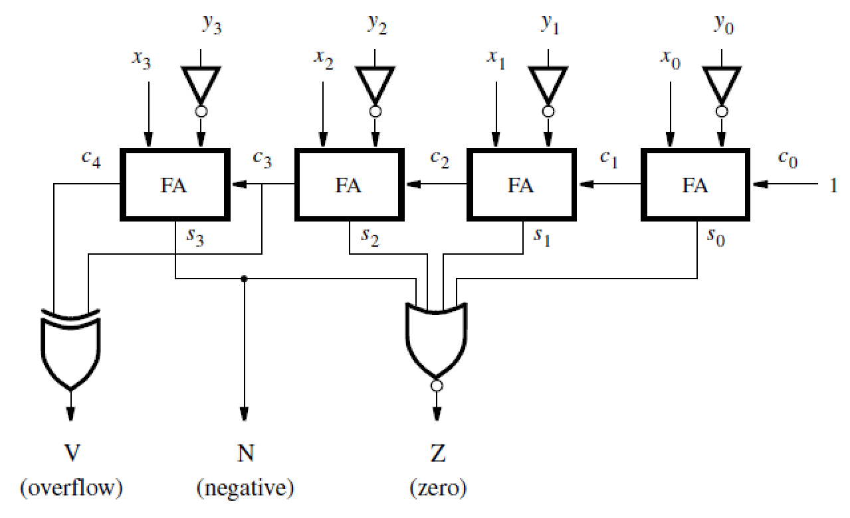

Slide 16
Consider first the case X < Y , where the following possibilities may arise:
• If X and Y have the same sign there will be no overflow, hence V = 0. Then for both positive and negative X and Y the difference will be negative (N = 1).
• If X is negative and Y is positive, the difference will be negative (N = 1) if there is no overflow (V = 0); but the result will be positive (N = 0) if there is overflow (V = 1).
Therefore, if X < Y then N ⊕ V = 1.
The case X = Y is detected by Z = 1. Then, X ≤ Y is detected by Z + (N ⊕ V) = 1.
X > Y if (Z + (N ⊕ V))’ = 1
X ≥ Y if (N ⊕ V)’ = 1.

Slide 17

Arithmetic Comparison Circuits
Let A = a3a2a1a0 and B = b3b2b1b0. Define a set of intermediate signals called i3, i2, i1, and i0. Each signal, ik , is 1 if the bits of A and B with the same index are equal.
That is, ik = (ak ⊕ bk)’ . The comparator’s AeqB output is then given by AeqB = i3i2i1i0 (i,e AND of all these intermediate signals must return 1)

Slide 18
